Slide 1
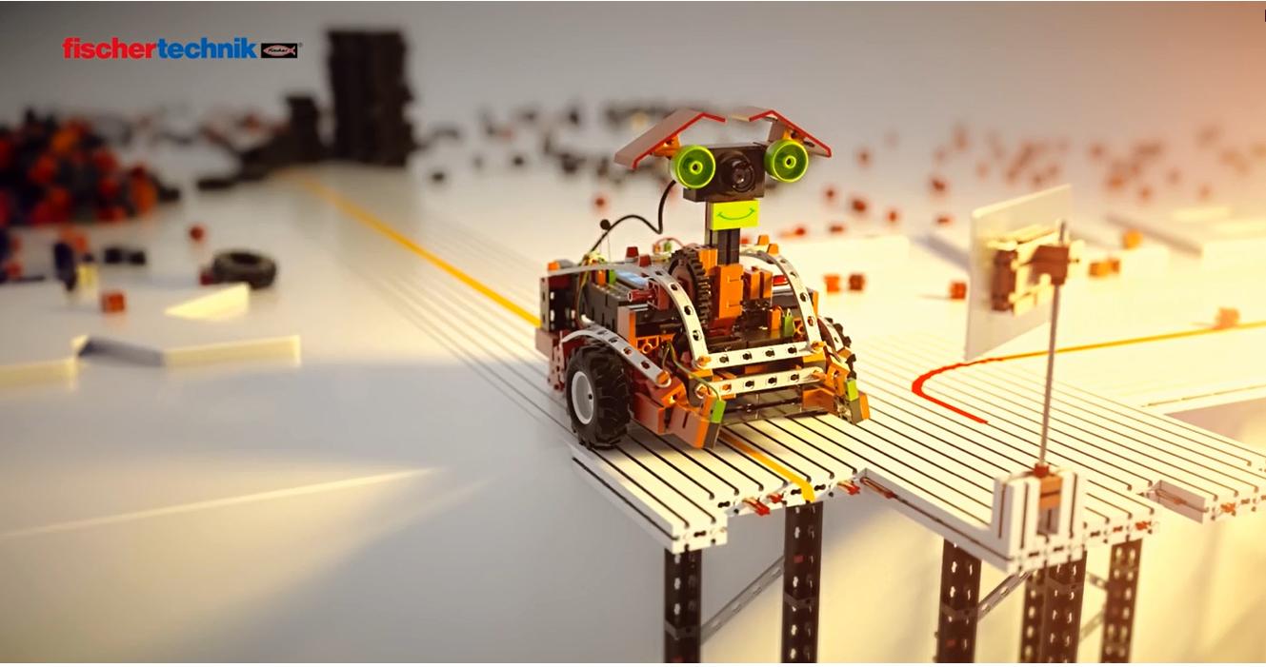
Proyecto VIP
Team:
Juan David Carvajal
Gerando Mera
Santiago Meza
Miguel Martínez

Slide 2
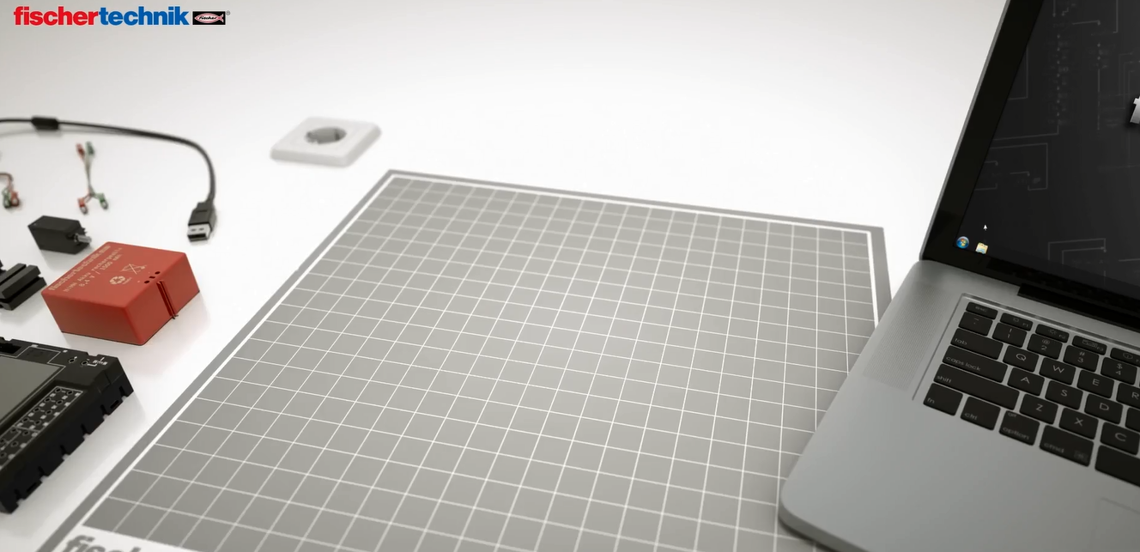
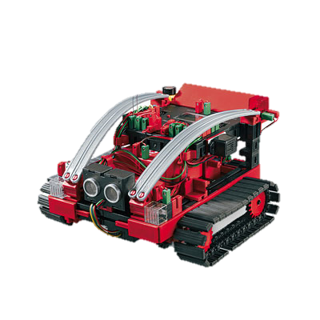
1.Summary
The project consists of a robot that has the capabilities to be autonomous in almost every way. The robot must traverse Icesi’s campus unsupervised, and without interaction with human controllers. This is an ambitious project with multiple applications in a variety of fields.

Slide 3
2. Investigation problem
design and build an autonomous vehicle
mobility by the university
identify accessible routes
able to avoid dangers

Slide 4
3. Justification
The robot allows:
identify routes that are difficult for people with disabilities to access
generate traffic maps (improve mobility)
people who want to know the university through the robot
for transportation work

Slide 5
4. Objectives (general and specific)
General Objective
Design and build a prototype of an autonomous vehicle using Fishchertechnik framework, that is to transit unsupervised around Icesi’s campus, avoiding danger to itself and others.
Especific Objective
Build a model capable of accomplishing the project requirements.
Program an algorithm that is capable of travelling autonomously and avoid dangers.
Integrate all software and hardware components in a single prototype that is functional and capable of operating without human interaction.

Slide 6
5. Methodology
Conceive the idea and define the Project scope: The scope of the Project should be clearly defined, along with the prototype’s functionality.
Design and construction of the physical structure: The design for the physical structure will be conceived considering the basic functions that it should have. The, the model will be constructed using a Fischertechnik model.
Development of the movement algorithm: The autonomous movement algorithm will be designed and implemented. This algorithm should be in capacity of guiding the robot through an open space with obstacles.

Slide 7
6. Expected results
make the prototype of the vehicle
the robot is able to move by themselves
the robot is able to avoid obstacles and correct its course

Slide 8
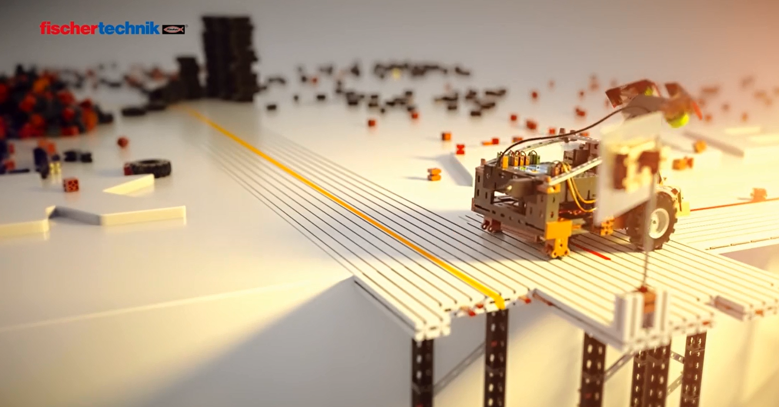
thanks for your attention

